Slide 1
ANOMALY DETECTION
Most of the material in this presentation taken from Text Book slides (Tan et. al.)

Slide 2
Statistical Approaches
Probabilistic definition of an outlier: An outlier is an object that has a low probability with respect to a probability distribution model of the data.
Usually assume a parametric model describing the distribution of the data (e.g., normal distribution)
Apply a statistical test that depends on
  Data distribution
  Parameters of distribution (e.g., mean, variance)
  Number of expected outliers (confidence limit)
Issues
  Identifying the distribution of a data set
    Heavy tailed distribution
  Number of attributes
  Is the data a mixture of distributions?

Slide 3
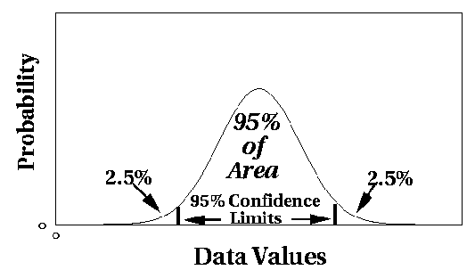
Outlier Discovery: Statistical Approaches
Assume a model underlying distribution that generates data set (e.g. normal distribution)
Use discordancy tests depending on
  data distribution
  distribution parameter (e.g., mean, variance)
  number of expected outliers
Drawbacks
  most tests are for single attribute
  In many cases, data distribution may not be known

Slide 7
Grubbs’ Test
Detect outliers in univariate data
Assume data comes from normal distribution
Detects one outlier at a time, remove the outlier, and repeat
  H₀: There is no outlier in data
  H_{A}: There is at least one outlier
Grubbs’ test statistic:
Reject H₀ if:

Slide 8
Statistical-based–Likelihood Approach
Assume the data set D contains samples from a mixture of two probability distributions:
  M (majority distribution)
  A (anomalous distribution)
General Approach:
  Initially, assume all the data points belong to M
  Let L_{t}(D) be the log likelihood of D at time t
  For each point x_{t} that belongs to M, move it to A
    Let L_{t+1} (D) be the new log likelihood.
    Compute the difference, Δ = L_{t}(D) – L_{t+1} (D)
    If Δ > c (some threshold), then x_{t} is declared as an anomaly and moved permanently from M to A

Slide 9
Statistical‐based – Likelihood
Approach

Slide 10
Strengths/Weaknesses of Statistical
Approaches
Firm mathematical foundation
Can be very efficient
Good results if distribution is known
In many cases, data distribution may not be known
For high dimensional data, it may be difficult to estimate the true distribution
Anomalies can distort the parameters of the distribution
Most of the tests are for a single attribute

Slide 11
Distance‐Based Approaches
Several different techniques
An object is an outlier if a specified fraction of the objects is more than a specified distance away (Knorr, Ng 1998)
  Some statistical definitions are special cases of this
The outlier score of an object is the distance to its kth nearest neighbor

Slide 12
Distance-based Approaches
Data is represented as a vector of features
Three major approaches
  Nearest-neighbor based
  Density based
  Clustering based

Slide 13
Nearest-Neighbor Based Approach
Approach:
  Compute the distance between every pair of data points
        Outlier score of an object is given by the distance to its k-nearest neighbor
  There are various ways to define outliers:
    Data points for which there are fewer than p neighboring points within a distance D
    The top n data points whose distance to the kth nearest neighbor is greatest
    The top n data points whose average distance to the k nearest neighbors is greatest

Slide 14
Nearest-Neighbor Based Approach
K=5

Slide 15
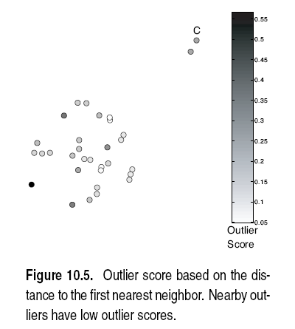
Nearest-Neighbor Based Approach
Approach highly sensitive to choice of K
K=1

Slide 16
Nearest-Neighbor Based Approach
Approach highly sensitive to choice of K
K=5
All points in smaller cluster have high Outlier Score
How to reduce sensitivity on K?
Complexity?

Slide 17
Nearest-Neighbor Based Approach
Strengths & Weaknesses
  + simple
  Complexity O(m²)
  Sensitive to choice of parameters
  Wide density variations not handles properly (global thresholds are used)
  Distance becomes less meaningful in high dimensional space

Slide 18
Nearest-Neighbor Based Approach

Slide 19
Density‐Based Approaches
Density‐based Outlier: The outlier score of an object is the inverse of the density around the object.
  Can be defined in terms of the k nearest neighbors
  One definition: Inverse of distance to kth neighbor
  Another definition: Inverse of the average distance to k neighbors
  DBSCAN definition
If there are regions of different density, this approach can have problems

Slide 20
Relative Density
Consider the density of a point relative to that of its k nearest neighbors

Slide 22
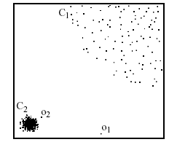
Density-based: LOF approach
For each point, compute the density of its local neighborhood
Compute local outlier factor (LOF) of a sample p as the average of the ratios of the density of sample p and the density of its nearest neighbors
Outliers are points with largest LOF value
In the NN approach, p₂ is not considered as outlier, while LOF approach find both p₁ and p₂ as outliers
p₂
×
p₁
×

Slide 23
Strengths/Weaknesses of Density‐Based Approaches
Simple
Expensive – O(n2)
Sensitive to parameters
Density becomes less meaningful in high dimensional space

Slide 24
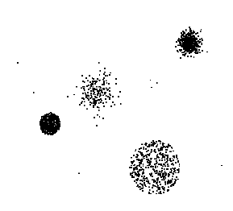
Clustering-Based
Basic idea:
  Cluster the data into groups of different density
  Choose points in small cluster as candidate outliers
  Compute the distance between candidate points and non-candidate clusters.
    If candidate points are far from all other non-candidate points, they are outliers

Slide 25
Clustering‐Based Approaches
Clustering‐based Outlier: An object is a cluster‐based outlier if it does not strongly belong to any cluster
  For prototype‐based clusters, an object is an outlier if it is not close enough to a cluster center
  For density‐based clusters, an object is an outlier if its density is too low
  For graph‐based clusters, an object is an outlier if it is not well connected
Other issues include the impact of outliers on the clusters and the number of clusters

Slide 28
Strengths/Weaknesses of Cluster‐Based Approaches
Simple
Many clustering techniques can be used
Can be difficult to decide on a clustering technique
Can be difficult to decide on number of clusters
Outliers can distort the clusters

Slide 29
Outliers in Lower Dimensional Projection
In high-dimensional space, data is sparse and notion of proximity becomes meaningless
  Every point is an almost equally good outlier from the perspective of proximity-based definitions
Lower-dimensional projection methods
  A point is an outlier if in some lower dimensional projection, it is present in a local region of abnormally low density

Slide 30

Outliers in Lower Dimensional Projection
Divide each attribute into φ equal-depth intervals
  Each interval contains a fraction f = 1/φ of the records
Consider a k-dimensional cube created by picking grid ranges from k different dimensions
  If attributes are independent, we expect region to contain a fraction f^{k} of the records
  If there are N points, we can measure sparsity of a cube D as:
  Negative sparsity indicates cube contains smaller number of points than expected

Slide 31
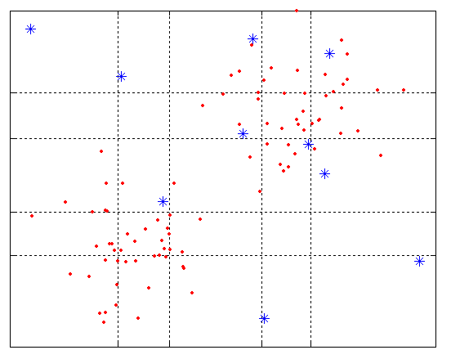
Example
N=100, φ = 5, f = 1/5 = 0.2, N × f² = 4

Slide 32


Base Rate Fallacy
Bayes theorem:
More generally:

Slide 33
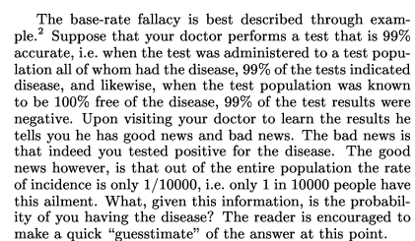
Base Rate Fallacy (Axelsson, 1999)

Slide 34


Base Rate Fallacy
Even though the test is 99% certain, your chance of having the disease is 1/100, because the population of healthy people is much larger than sick people

Slide 35
Base Rate Fallacy in Intrusion Detection
I: intrusive behavior,
¬I: non-intrusive behavior
A: alarm
¬A: no alarm
Detection rate (true positive rate): P(A|I)
False alarm rate: P(A|¬I)
Goal is to maximize both
  Bayesian detection rate, P(I|A)
  P(¬I|¬A)

Slide 36



Detection Rate vs False Alarm Rate
Suppose:
Then:
False alarm rate becomes more dominant if P(I) is very low

Slide 37
Hierarchical Clustering: Revisited
Creates nested clusters
Agglomerative clustering algorithms vary in terms of how the proximity of two clusters are computed
    MIN (single link): susceptible to noise/outliers
    MAX/GROUP AVERAGE:
    may not work well with non-globular clusters
  CURE algorithm tries to handle both problems
Often starts with a proximity matrix
  A type of graph-based algorithm

Slide 38
CURE: Another Hierarchical Approach
Uses a number of points to represent a cluster
Representative points are found by selecting a constant number of points from a cluster and then “shrinking” them toward the center of the cluster
Cluster similarity is the similarity of the closest pair of representative points from different clusters
×
×

Slide 39
CURE
Shrinking representative points toward the center helps avoid problems with noise and outliers
CURE is better able to handle clusters of arbitrary shapes and sizes

Slide 40
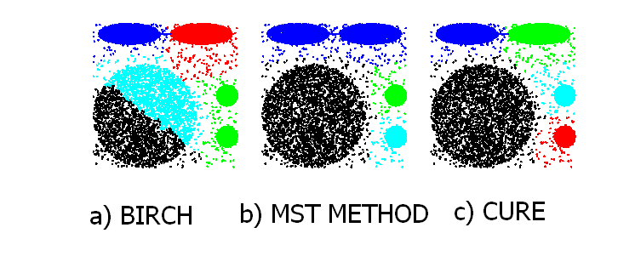
Experimental Results: CURE
Picture from CURE, Guha, Rastogi, Shim.

Slide 41
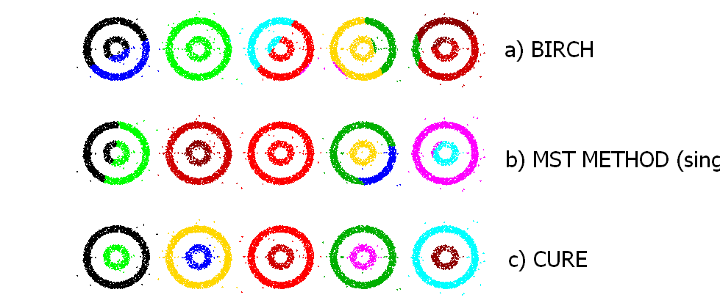
Experimental Results: CURE
(centroid)
(single link)
Picture from CURE, Guha, Rastogi, Shim.

Slide 42
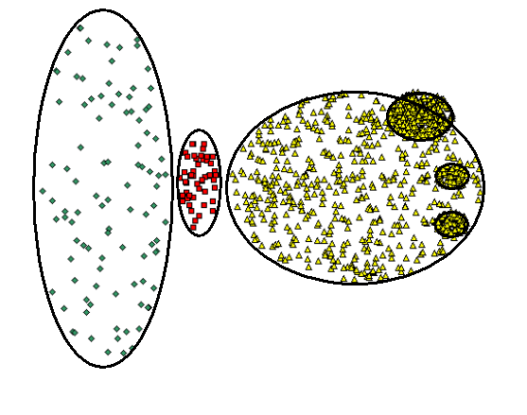
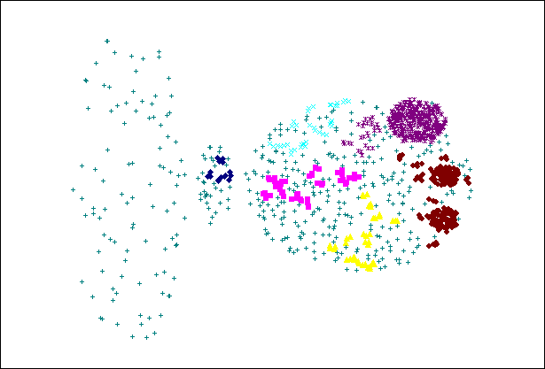
CURE Cannot Handle Differing Densities
Original Points
CURE

Slide 43
Graph-Based Clustering
Graph-Based clustering uses the proximity graph
  Start with the proximity matrix
  Consider each point as a node in a graph
  Each edge between two nodes has a weight which is the proximity between the two points
  Initially the proximity graph is fully connected
  MIN (single-link) and MAX (complete-link) can be viewed as starting with this graph
In the simplest case, clusters are connected components in the graph

Slide 44
Graph-Based Clustering: Sparsification
The amount of data that needs to be processed is drastically reduced
  Sparsification can eliminate more than 99% of the entries in a proximity matrix
  The amount of time required to cluster the data is drastically reduce
  The size of the problems that can be handled is increased

Slide 45
Graph-Based Clustering: Sparsification …
Clustering may work better
  Sparsification techniques keep the connections to the most similar (nearest) neighbors of a point while breaking the connections to less similar points.
  The nearest neighbors of a point tend to belong to the same class as the point itself.
  This reduces the impact of noise and outliers and sharpens the distinction between clusters.
Sparsification facilitates the use of graph partitioning algorithms (or algorithms based on graph partitioning algorithms.
  Chameleon and Hypergraph-based Clustering

Slide 46
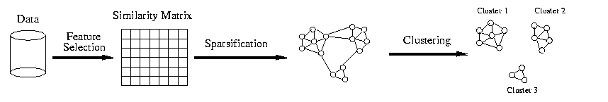
Sparsification in the Clustering Process

Slide 47
Limitations of Current Merging Schemes
Existing merging schemes in hierarchical clustering algorithms are static in nature
  MIN or CURE:
    merge two clusters based on their closeness (or minimum distance)
  GROUP-AVERAGE:
    merge two clusters based on their average connectivity

Slide 48
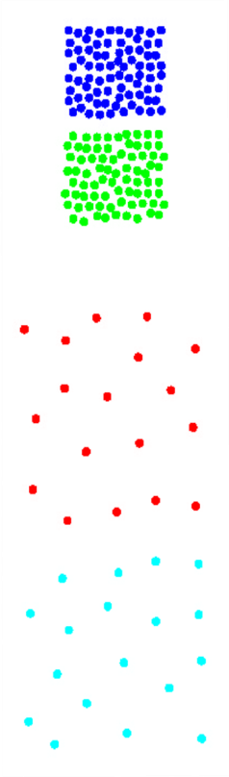
Limitations of Current Merging Schemes
(a)
Closeness schemes will merge (a) and (b)
(b)
Average connectivity schemes will merge (c) and (d)
(c)
(d)

Slide 49
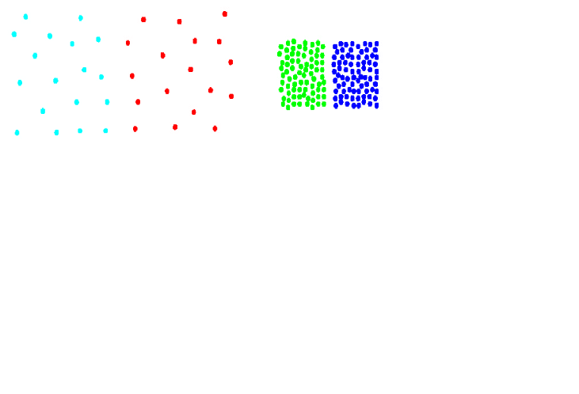
Chameleon: Clustering Using Dynamic Modeling
Adapt to the characteristics of the data set to find the natural clusters
Use a dynamic model to measure the similarity between clusters
  Main property is the relative closeness and relative inter-connectivity of the cluster
  Two clusters are combined if the resulting cluster shares certain properties with the constituent clusters
  The merging scheme preserves self-similarity
One of the areas of application is spatial data

Slide 50
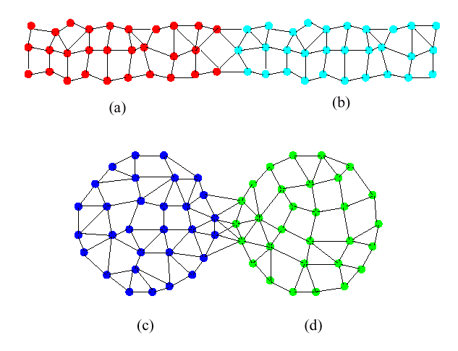
Limitations of Current Merging Schemes
(a)
(b)
(c)
(d)
Shows relative closeness
Shows inter connectedness

Slide 51
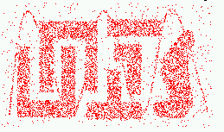
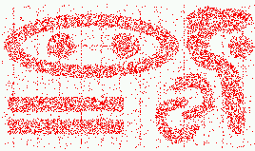
Characteristics of Spatial Data Sets
  Clusters are defined as densely populated regions of the space
  Clusters have arbitrary shapes, orientation, and non-uniform sizes
  Difference in densities across clusters and variation in density within clusters
  Existence of special artifacts (streaks) and noise
The clustering algorithm must address the above characteristics and also require minimal supervision.

Slide 52
Chameleon: Steps
Preprocessing Step:
Represent the Data by a Graph
  Given a set of points, construct the k-nearest-neighbor (k-NN) graph to capture the relationship between a point and its k nearest neighbors
  Concept of neighborhood is captured dynamically (even if region is sparse)
Phase 1: Use a multilevel graph partitioning algorithm on the graph to find a large number of clusters of well-connected vertices
  Each cluster should contain mostly points from one “true” cluster, i.e., is a sub-cluster of a “real” cluster

Slide 53
Chameleon: Steps …
Phase 2: Use Hierarchical Agglomerative Clustering to merge sub-clusters
  Two clusters are combined if the resulting cluster shares certain properties with the constituent clusters
  Two key properties used to model cluster similarity:
    Relative Interconnectivity: Absolute interconnectivity of two clusters normalized by the internal connectivity of the clusters
    Relative Closeness: Absolute closeness of two clusters normalized by the internal closeness of the clusters

Slide 54
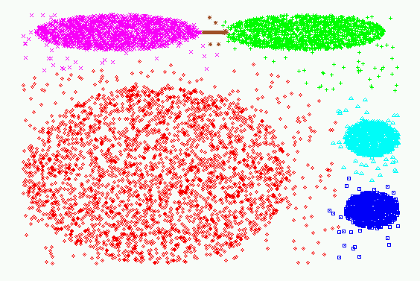
Experimental Results: CHAMELEON

Slide 55
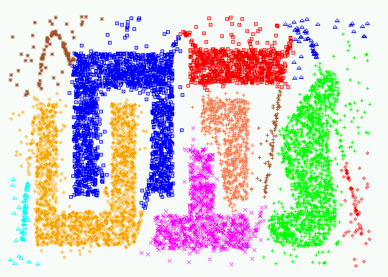
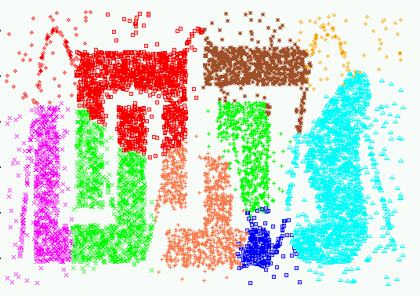
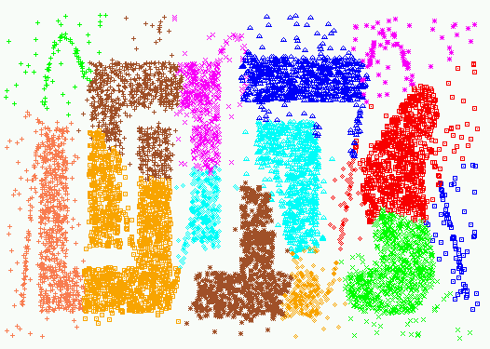
Experimental Results:
CHAMELEON
CURE (10 clusters)
CURE (15 clusters)

Slide 56
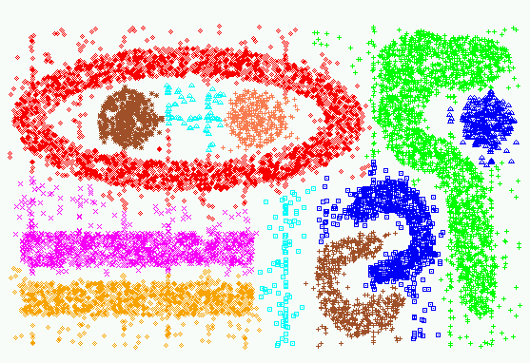
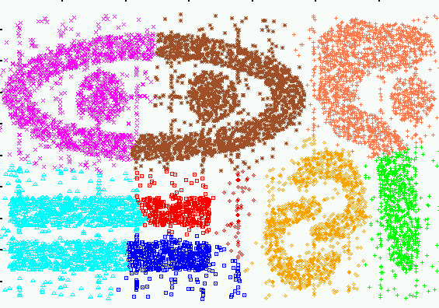
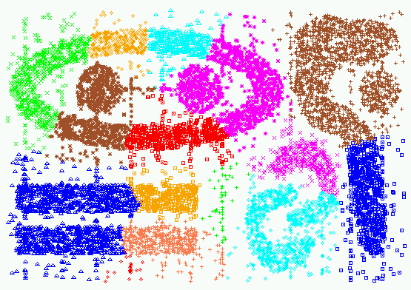
Experimental Results:
CHAMELEON
CURE (9 clusters)
CURE (15 clusters)

